Slide 1



INSTRUCTION
NO | Item | Method | Tool, Jig & Equipment | Sampling & AQL
1 | Aluminum sheet | Dimensional Check includes width, & thickness, also Third party inspection for chemical & mechanical properties. | Measuring Tape ,UTM Hardness Tester & lab Report | N=1
2 | Coating Powder | Coated powder sample should be check for impact test, shade, cross cut test & visually powder batch , type . | Cross cut tester, Impact tester | N=1
3 | Cu-Al Joint | Dimensional inspection as per drawing & visually check for burr, sharp edges, glue mark etc. | Pin Gauge, Vernier, Measuring Tape | S-1, AQL=2.5
4 | Plug / Protection cap | Dimensional check as per drawing & visually check flashes, cracks, hairline crack under light. | Pin Gauge, Vernier caliper, Micrometer | S-1, AQL=2.5
5 | Corrugated Box | Dimensional inspection as per drawing & visually check for damage, pesting issue, cutting issue. | Measuring Tape, BS machine, weighting meter | S-1, AQL=2.5
6 | Corrugated Plate | Dimensional inspection as per drawing & visually check for damage, pesting issue, cutting issue. | Measuring Tape, BS machine, weighting meter | S-1, AQL=2.5
7 | PP Box | Dimensional inspection as per drawing & visually check for damage ,cutting issue. | Test set-up / Weighing Machine | S-1, AQL=2.5
8 | Foam Plate | Dimensional inspection as per drawing & visually check for damage ,cutting issue. | Cross cut Tester | S-1, AQL=2.5
9 | Aluminum tube | Dimensional Check includes OD, & thickness, also Third party inspection for chemical & mechanical properties. | Measuring Tape ,UTM Hardness Tester & lab Report | N=1
F-CMIPL-IQA-036/01

Slide 2
INSTRUCTION
NO | Item | Method | Tool, Jig & Equipment | Sampling & AQL
10 | Welding Rod | Check the OD of rod & visual criteria | Check the OD of rod & visual criteria | Check the OD of rod & visual criteria
11 | Copper Tube | Dimensional Check includes OD, & thickness, also Third party inspection for chemical & mechanical properties. | Measuring Tape ,UTM Hardness Tester & lab Report | N=1
12 | Accumulator | Dimensional Check includes OD, & thickness, also Third party inspection for chemical & mechanical properties. | Vernier caliper, Micrometer | S-1, AQL=2.5
13 | Aluminum Foil | Dimensional Check includes thickness ,Length also Third party inspection for chemical properties. | Measuring Tape, Micrometer. lab Report | N=1
14 | SS Sleeve | Check the OD ,Thickness , length & visual criteria | Vernier caliper, Micrometer | S-1, AQL=2.5
15 | LH / RH Plate | Dimensional Check includes thickness ,Length. & visual criteria. | Vernier caliper, Micrometer | S-1, AQL=2.5
16
17
18
F-CMIPL-IQA-036/01

Slide 3
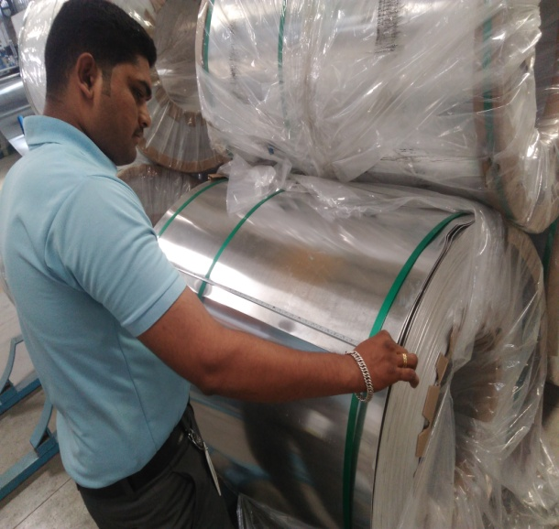
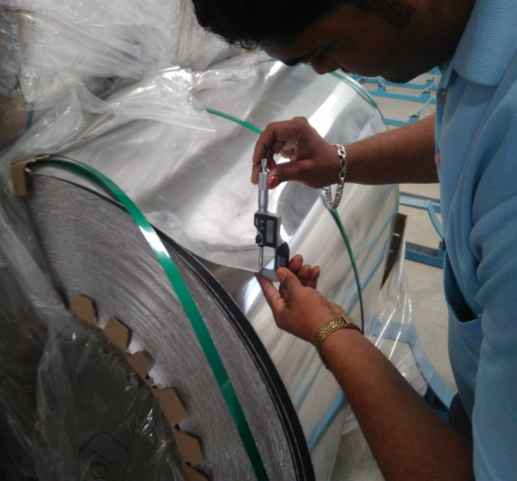
ALUMINIUM COILS INSPECTION
Main Inspection Item : Aluminium Sheet
Inspection Item | Inspection Method | Judgment
Aluminium sheet Width of coil (1100 & 1200 mm +/- 4 mm) Thickness of sheet (1.5 & 2 mm +/- 0.05) Mechanical properties Chemical properties | Aluminium coil width checked by measuring tape as per std. Check the thickness by using micrometer. Visual check for entire lot as any water mark or abnormality seen in material. 4. After in house inspection we sent sample to NABL approved lab for third party inspection. | Aluminium coil should be as per specification
F-CMIPL-IQA-037/01

Slide 4
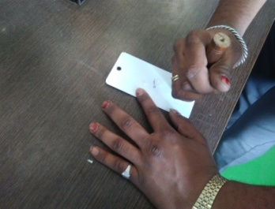
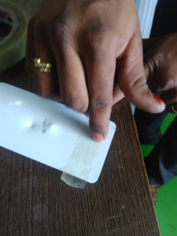
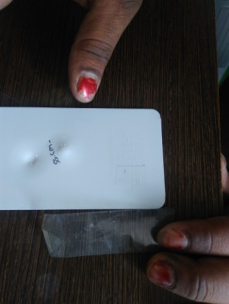
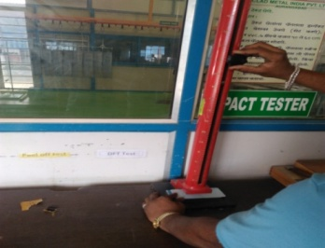
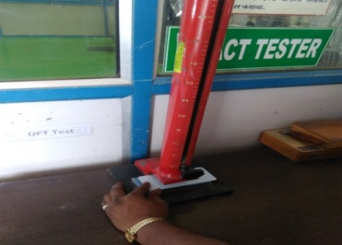
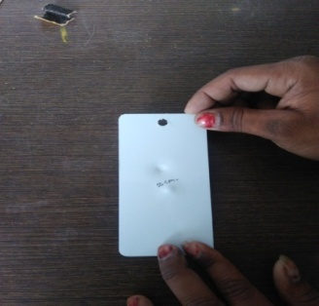
COATING SAMPLE INSPECTION
Main Inspection Item : Coating Powder
Inspection Item | Inspection Method | Judgment
Coating Powder Coating sample inspection for impact test & cross cut test, Visual check for batch no. | Batch sample should be check for cross cut test & Impact test. Do Cross cut on Printed area of Part (100 blocks of 1mm each) Apply Tape on Cross cut area Paste Tape using manual force Remove Tape at 15 deg abruptly Placed the sample under impact tester Put the ball at 55 CM height Leave the ball from that height Check the sample Check the batch no on boxes. | No Coating peel off after cross cut test No crack should be observed on tested surface Batch no. should be as per sample batch no.
F-CMIPL-IQA-037/01

Slide 5
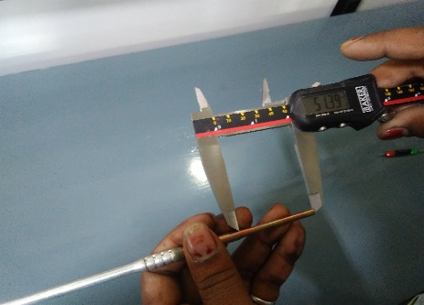
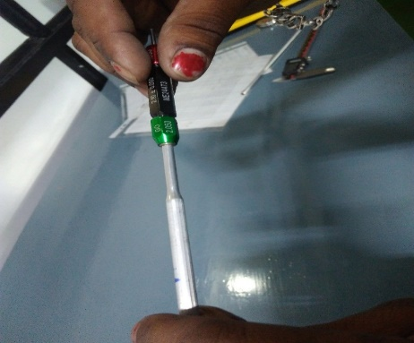
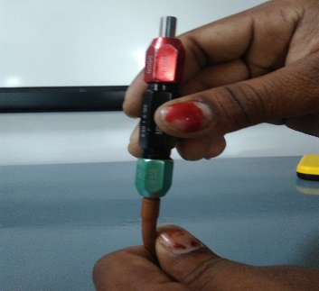
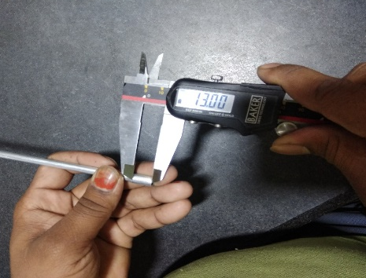
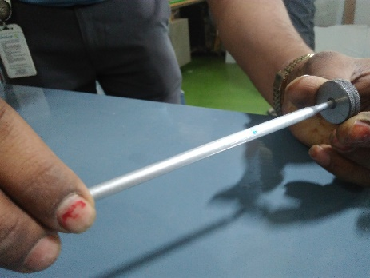
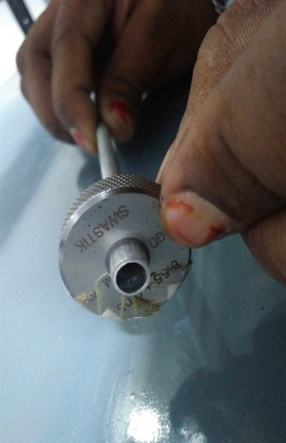
JOINTS INSPECTION
Main Inspection Item : Cu-Al Joint
Inspection Item | Inspection Method | Judgment
Cu-Al Joint Al tube length Cu tube length Cu-Al Tube OD Cu-Al Tube ID Visual check | 1. Check the al tube length as per specification by Vernier caliper 2. Check the cu tube length as per specification by Vernier caliper 3. Check the inlet ID & outlet ID as per specification by pin gauge 4. Check the inlet OD & outlet OD as per specification by Vernier caliper or ring gauge. 5. Check for visual check points such as burr, line mark, damage etc. | Dimensional parameter should be as per specification. Visually material should be free from burr, line mark, damage.
F-CMIPL-IQA-037/01

Slide 6
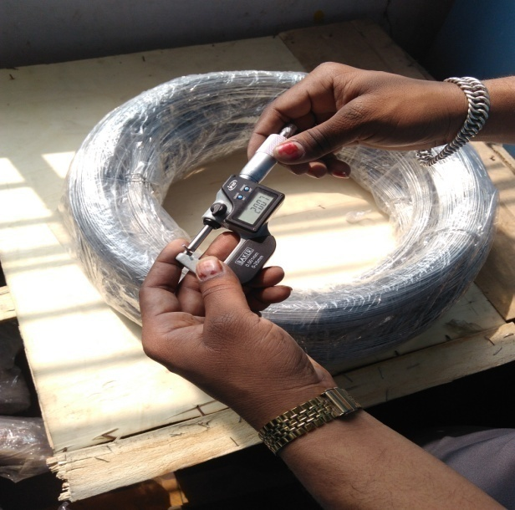
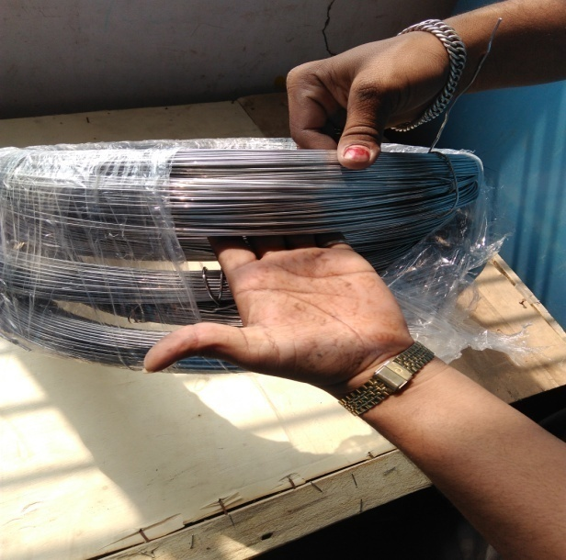
WELDING WIRE INSPECTION
Main Inspection Item : Welding Rod
Inspection Item | Inspection Method | Judgment
Welding Rod Rod OD ( 2 mm +/- 0.1 mm) Visual Check Chemical Properties | Check the OD of welding rod by micrometer. Visually check that rod should be free from oil & dust. Chemical properties should be checked from NABL lab | Dimensional parameter should be as per specification Visually material should be free from oil & dust, blackish Chemical properties should be as per specification
F-CMIPL-IQA-037/01

Slide 7
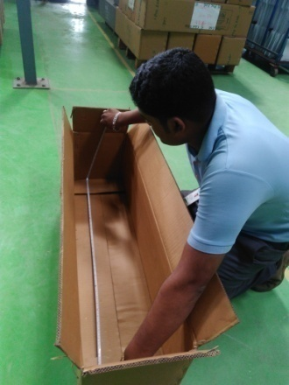
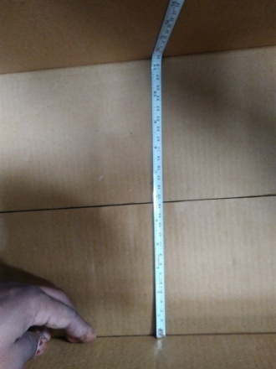
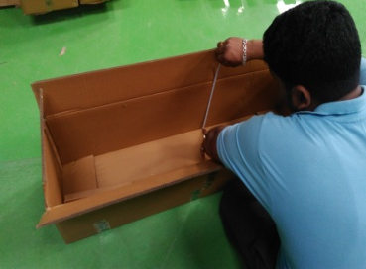
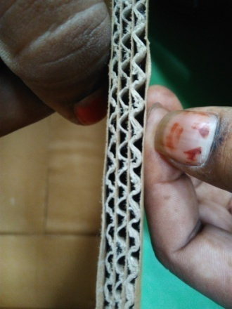
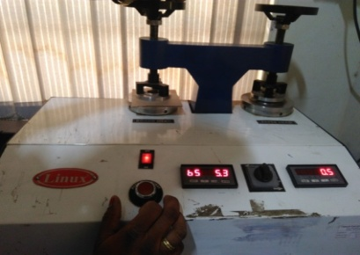
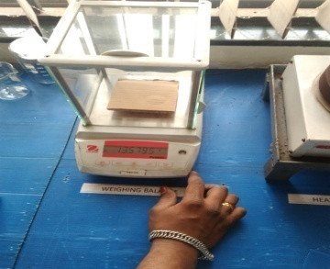
CORRUGATED BOX INSPECTION
Main Inspection Item : Corrugated Box
Inspection Item | Inspection Method | Judgment
Corrugated Box Box Length Box Width Box Height Box No. of ply Box BS of sheet GSM of Sheet Visual check | Length of box should be check by measuring tape Width of boxes should be check by measuring tape Height of boxes should be check by measuring tape No. of Ply should be check visually. BS of sheet checked by BS machine. Calculate the GSM by using weighing machine. Visual checking for pesting of paper, cutting of paper, printing of company logo if required. | Dimensional parameter should be as per specification Visually material should be free from pesting issue, cutting issue, printing issue.
F-CMIPL-IQA-037/01

Slide 8
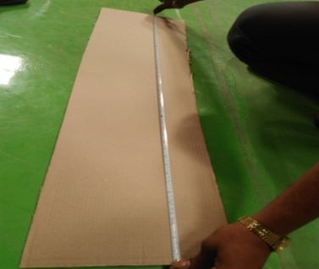
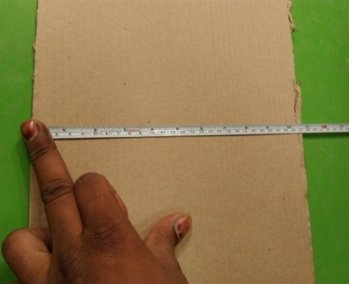
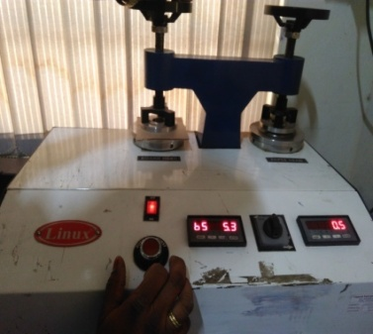

CORRUGATED PLATE INSPECTION
Main Inspection Item : Corrugated Plate
Inspection Item | Inspection Method | Judgment
Corrugated Box Plate Length Plate Width No. of ply BS of sheet GSM of Sheet Visual check | Length of plate should be check by measuring tape Width of plate should be check by measuring tape No. of Ply should be check visually. BS of sheet checked by BS machine. Calculate the GSM by using weighing machine. Visual checking for pesting of paper, cutting of paper, printing of company logo if required. | Dimensional parameter should be as per specification Visually material should be free from pesting issue, cutting issue, printing issue.
F-CMIPL-IQA-037/01

Slide 9
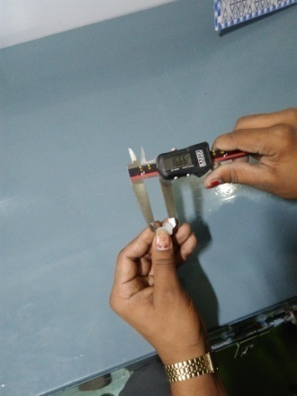
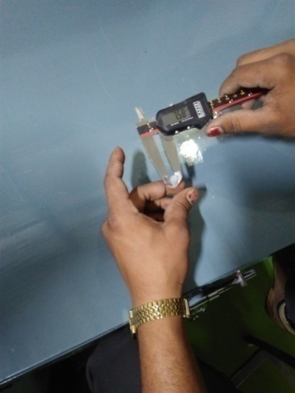
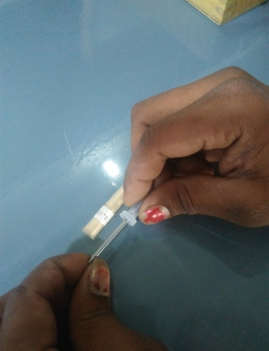
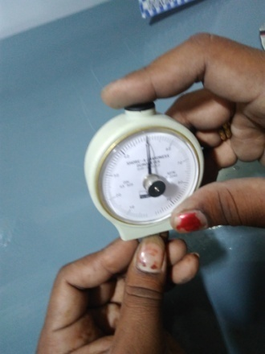
RUBBER CAP’S INSPECTION
Main Inspection Item : Plug / Protection cap
Inspection Item | Inspection Method | Judgment
Plug cap Cap length Cap OD Cap ID Hardness Visual | 1. Check the cap length as per specification by Vernier caliper 2. Check the cap OD as per specification by Vernier caliper 3. Check the cap ID by pin gauge 4. Check the hardness by using hardness tester. 5. Check for visual check points such as flashes, crack, hairline etc. | Dimensional parameter should be as per specification. Visually material should be free from Flashes, crack, Cut Mark.
F-CMIPL-IQA-037/01

Slide 10
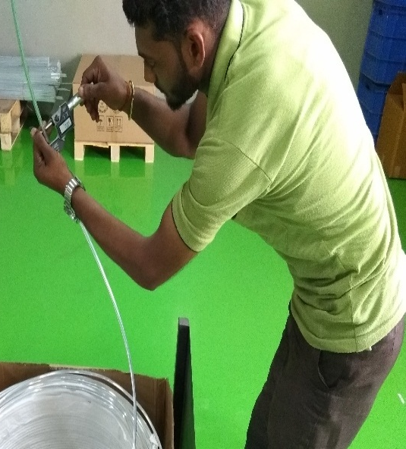
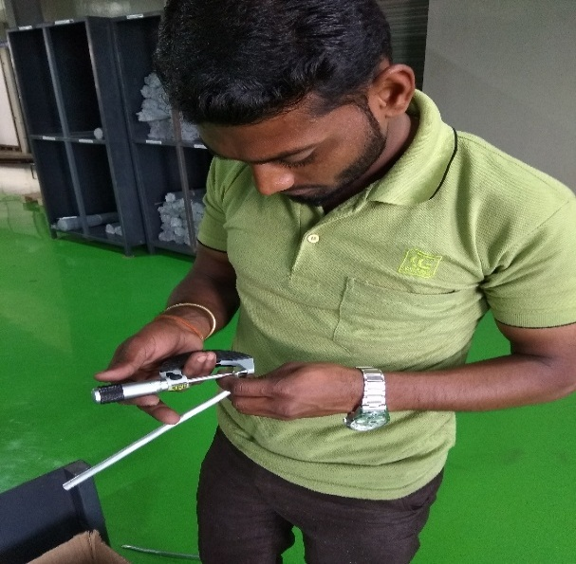
ALUMINIUM TUBE INSPECTION PROCESS
Main Inspection Item : Aluminium Tube
Inspection Item | Inspection Method | Judgment
Aluminum Tube All OD of tube (8 +/- 0.05 mm ) -Thickness of sheet (0.60 mm +/- 0.05) -Mechanical properties -chemical properties | Aluminium tube OD checked by micrometer as per std. Aluminium tube ID checked by the pin gauge Check the thickness by using micrometer. Visual check for entire lot as any line mark or abnormality seen in material. After in house inspection we sent sample to NABL approved lab for third party inspection. | Aluminium tube should be as per specification
F-CMIPL-IQA-037/01

Slide 11
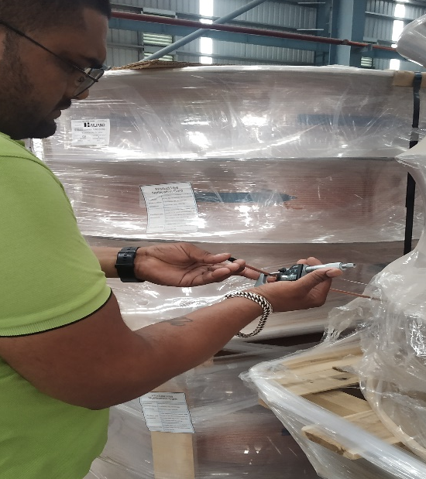
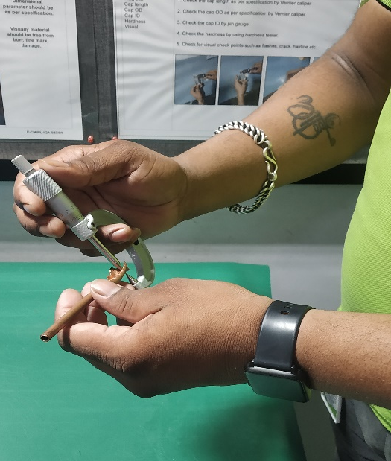
COPPER TUBE INSPECTION PROCESS
Main Inspection Item : Copper Tube
Inspection Item | Inspection Method | Judgment
Copper Tube All OD of tube -Thickness of Tube -Mechanical properties -Chemical properties | Copper tube OD checked by micrometer as per std. 2 Check the thickness by using Point micrometer. Visual check for entire lot as any line mark, Blackish ,Damage or abnormality seen in material. After in house inspection we sent sample to NABL approved lab for third party inspection. | Copper tube should be as per specification
F-CMIPL-IQA-037/01

Slide 12
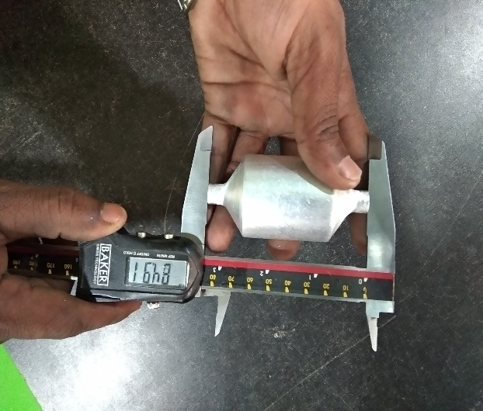
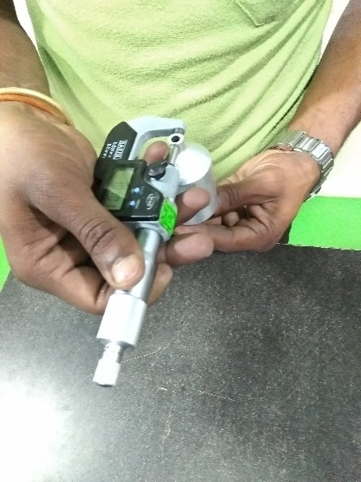
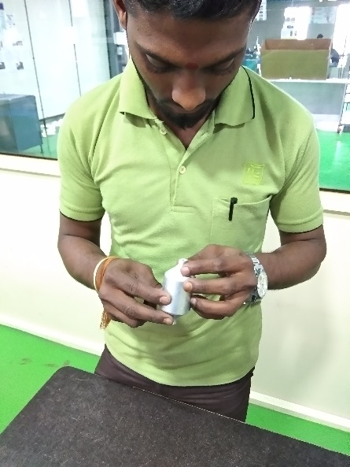
ACCUMULATOR INSPECTION PROCESS
Main Inspection Item : Accumulator
Inspection Item | Inspection Method | Judgment
Accumulator -Length -OD -Visual | Check the OD of accumulator by Vernier Caliper Check the length of the accumulator by the Vernier Caliper . Visually Check for accumulator should be free from Burr ,Damage and Crack. | Dimensional parameter should be as per specification Visually material should be free from burr & Damage.
F-CMIPL-IQA-037/01

Slide 13
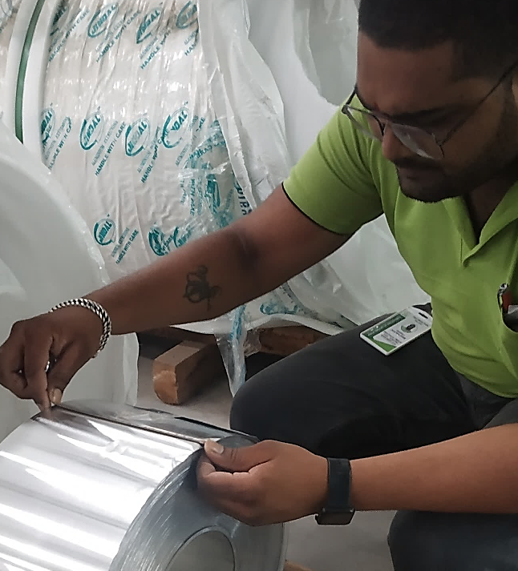
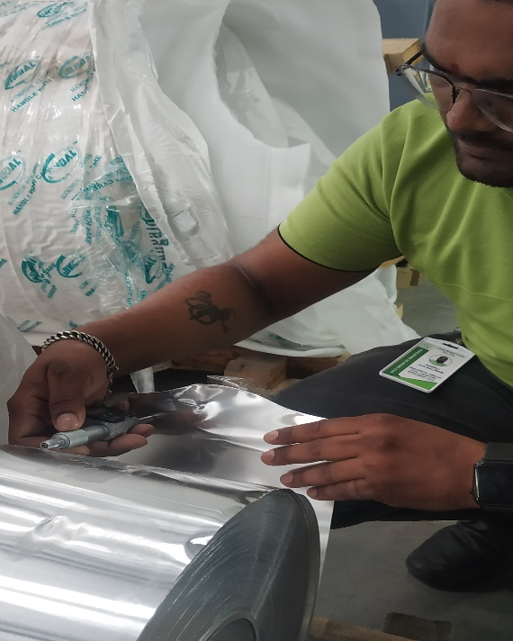
ALUMINIUM FOIL INSPECTION
Main Inspection Item : Aluminum Foil
Inspection Item | Inspection Method | Judgment
Aluminum Foil -Width -Thickness of sheet Chemical properties | Aluminum Foil width checked by measuring tape as per std. Check the thickness by using micrometer. Visual check for entire lot as any water mark or abnormality seen in material. 4. After in house inspection we sent sample to NABL approved lab for third party inspection. | Aluminum Foil should be as per specification
F-CMIPL-IQA-037/01

Slide 14
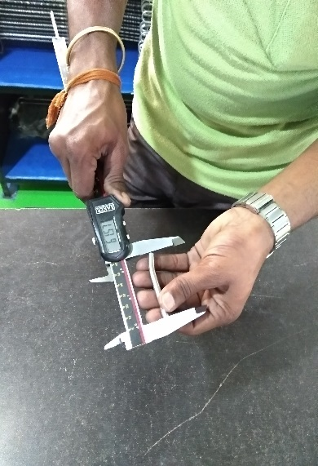
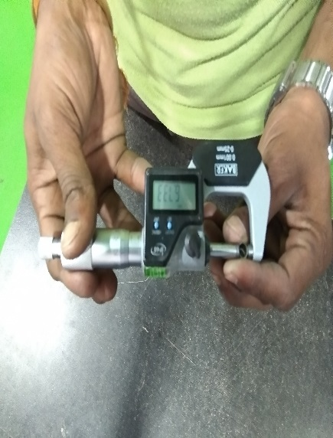
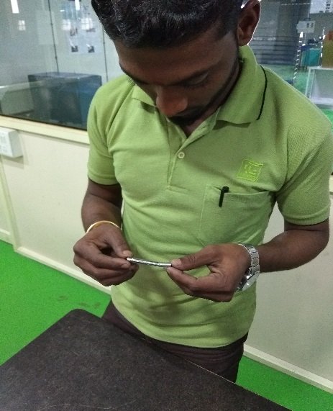
SS SLEEVE INSPECTION
Main Inspection Item : SS Sleeve
Inspection Item | Inspection Method | Judgment
SS sleeve Length OD visual | Check the OD of sleeve by micrometer. Check the length of the sleeve by the Vernier caliper Visually check for sleeve should be free from burr & damage. | Dimensional parameter should be as per specification Visually material should be free from burr & damage
F-CMIPL-IQA-037/01

Slide 15
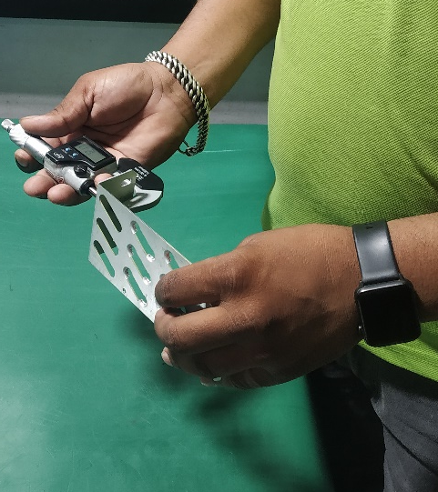
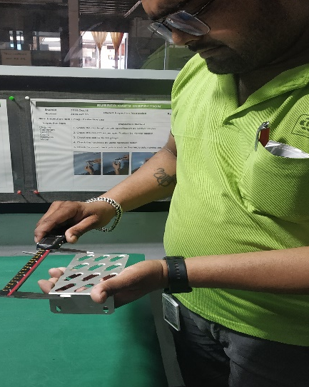
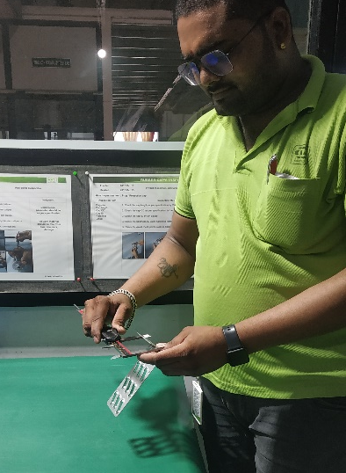
LH / RH PLATE INSPECTION
Main Inspection Item : LH / RH Plate
Inspection Item | Inspection Method | Judgment
LH / RH Plate Profile check Visual check | Check the thickness by using micrometer 2 Check the all plate dimension by the Vernier Caliper 3. Check the plate by visually should be free from burr, damage . | It should be free from burr & damage.
F-CMIPL-IQA-037/01

Slide 16
INSPECTION PROCESS
Main Inspection Item :Shelf life Item
Inspection Item | Inspection Method | Judgment
1)EPP LG SUPER WHITE POWDER 2)INK WHITE 3)INK BLACK 4)BONDRITE NT-1 5)BONDRITE 2520 | 1. Check material as per received invoice. 2. First GRN At store. 3. Check the QA MTC Verification & confirm MFG & EXP date. 4. Tick mark on the Date.. 5. Record report Maintain in the file . | Mfg. & Exp date should be as per MTC. Visually material should be free from, Damage & Leak
F-CMIPL-IQA-037/01

